Slide 1

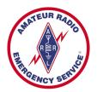
Training Volunteers
The ARRL
Introduction to Emergency Communication Course
EC-001 (2011)
Session One
Notes:
Make sure you have modified the Name and Date.
Display this screen as students are arriving for class.

Slide 2
Reminder
Complete two DHS/FEMA Courses
IS-100.b Introduction to ICS
IS-700 National Incident Management System
Http://training.fema.gov/IS/NIMS.asp
Notes:
ARRL conditions!
The two ICS courses must be complete before taking the final exam.

Slide 3
Session One Topic
Session 1 – Topics 1, 2, 3, 4, 5a, 5b
Session 2 – Topics 6, 7a, 7b, 7c, 7d, 8, 9, 10
Session 3 – Topics 11, 12, 13, 14, 15
Session 4 – Topics 16, 17, 18, 19, 20
Session 5 – Topics 21, 22, 23, 24, 25, 26, 27
Session 6 – Topics 28, 29, Summary, Final Exam
Notes:
The course requires a total of 18 hours.
If a student misses one class they can take a practice quiz for each lesson missed.
A student missing two sessions will be asked to take the course again.
A student missing the last session must wait for the next class and attend the final session for taking the exam again.
An exception would be two Field Examiners agreeing to give the exam at a mutually scheduled time.

Slide 4
Topic 4 – Emergency Communication Organizations and Systems

Slide 5
Why is organization important to emcomm?
Imagine a random group of volunteers trying to tackle a full-scale disaster communication emergency, working together for the first time
They do not know each other well, have very different approaches to solving the same problem, and half of them want to be in charge
Get the picture?
Notes:
It is not too far fetched. Just ask anyone who has been around emcomm for a while -- they have seen it! This course is intended to help solve that problem, but without emcomm organizations, this course would be worthless.

Slide 6
Why is organization important to emcomm?
Emcomm organizations:
Provide training
Develop workable solutions in advance of a real disaster
You will be as prepared as you can be.
Response will occur more smoothly
Challenges will be dealt with productively
The served agency's needs are met
Notes:
Some of the organizations discussed here do not directly involve Amateur Radio operators, but knowing about them and how they might assist in an emergency may be helpful. Your served agency may utilize or interact with one or more of these systems or organizations.

Slide 7
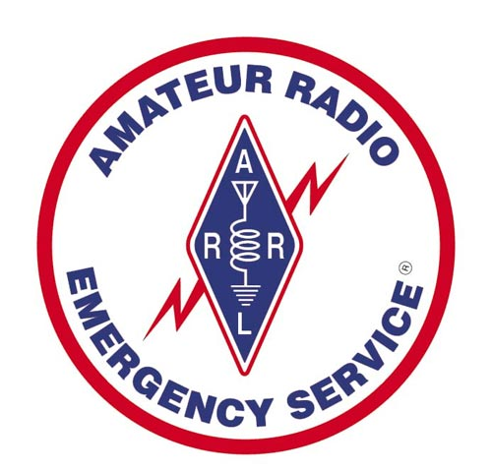
ARES

Slide 8
Amateur Radio Emergency Service (ARES)
Program sponsored by the ARRL since 1935
The League's field organization is composed of
"Sections“ and “Districts”
Elected Section Manager (SM) appoints the ARES leadership
Notes:
In this case, each District is guided by a District Emergency Coordinator (DEC), working directly under the SEC.
The next subdivision within ARES is the "county" or similar region assigned to an Emergency Coordinator (EC). Most ECs will have one or more Assistant Emergency Coordinators (AEC), who may have responsibility for specific tasks or cities. A large city with complex needs may have its own EC, but most towns and smaller cities will have an AEC.

Slide 9
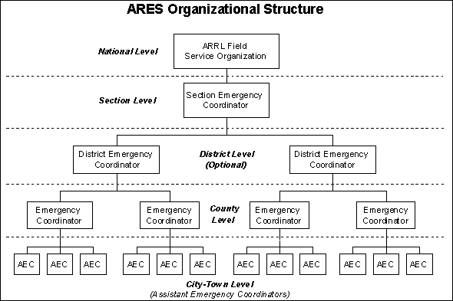
ARES Organization Structure
SM = Lee Cooper
SEC = Tom Whiteside
Assistant Section
Emergency Coordinator
STX

Slide 10
ARES MOUs
ARES MOUs at the national level:
Federal Emergency Management Agency (FEMA)
American Red Cross
Salvation Army
National Weather Service
Local groups often have MOUs or other written/verbal agreements with:
State and city emergency management departments
Hospitals
Schools
Police and fire departments
Public works agencies

Slide 11
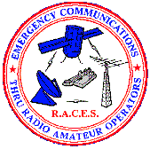
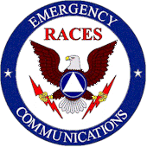
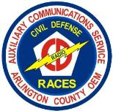
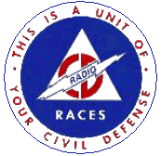
RACES

Slide 12
Why RACES?
Recall, the FCC or President can suspend amateur radio operations due to a national emergency
If the President invokes his War Emergency Powers, amateurs involved with RACES might be limited to certain specific frequencies (while all other amateur operation could be silenced)
RACES, supported by the Federal Emergency Management Agency (FEMA) is a part of the Amateur Radio Service providing radio communications for civil-preparedness purposes only, during periods of local, regional or national civil emergencies

Slide 13
RACES
"Civil Defense" now known as “Emergency Management" in most states utilize Amateur radio operators and has changed dramatically.
Fewer "pure" RACES operators today
Increasingly, RACES-registered operators also belong to ARES, and can "switch hats“
Emergency management officials like this arrangement since it provides more flexibility and control over their ham radio volunteers.

Slide 14
RACES Rules
A station operating under RACES may only communicate with:
1) A RACES station licensed to the local civil defense organization;
2) Other RACES licensees;
3) Certain US government stations authorized by the responsible agency to communicate with RACES stations and;
5) Stations in a service regulated by the FCC when authorized by the FCC [97.407(d)].
A station operating in ARES may communicate with any amateur station.

Slide 15
Switching Hats
Although RACES and ARES are separate entities, the ARRL advocates dual membership and cooperative efforts between both groups whenever possible for an ARES group whose members are all enrolled in and certified by RACES to operate in an emergency with great flexibility.
For example, during a "non-declared emergency," ARES can operate under ARES, but when an emergency or disaster is officially declared by a state or federal authority, the operation can become RACES with no change in personnel or frequencies

Slide 16
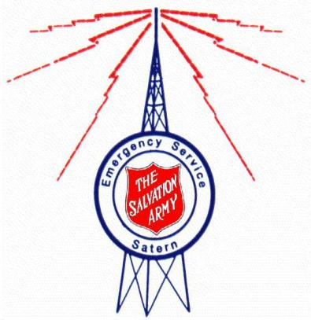
SATERN

Slide 17
Salvation Army Team Emergency Radio Network (SATERN)
Salvation Army volunteers
Partner with FEMA, participate in NVOAD
National Voluntary Organizations Active in Disaster, and with volunteer organizations (VOADS) on state and local levels
HF networks
Logistical communication between various Salvation Army offices
Health and welfare messages

Slide 18
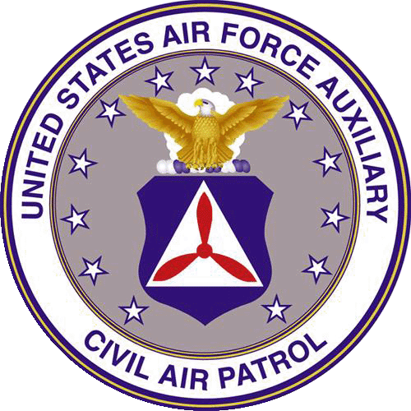
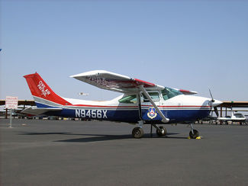
Civil Air Patrol

Slide 19
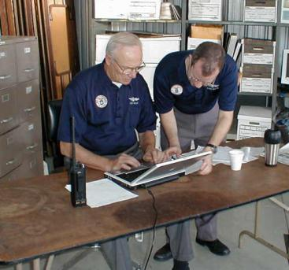
Civil Air Patrol
The nation-wide CAP communication system has 840 high-frequency radio stations, 5,000 fixed-land radio stations and 10,000 mobile radios, deployed in CAP units in every state, the District of Columbia and Puerto Rico

Slide 20
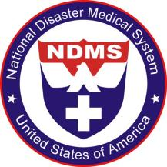
National Disaster Medical System (NDMS)
Federally coordinated system that augments the Nation's medical response capability
National Response Framework utilizes the National Disaster Medical System (NDMS), as part of the Department of Health and Human Services, Office of Preparedness and Response, under Emergency Support Function #8
National Disaster Medical System (NDMS) Response Teams
Disaster Medical Assistance Team (DMAT)
Disaster Mortuary Operational Response Teams (DMORT)
National Veterinary Response Team (NVRT)
National Nurse Response Team (NNRT)
National Pharmacy Response Teams (NPRTs)

Slide 21


Rapid Response Teams

Slide 22
The "Rapid Response Team" (RRT)
First minutes of an emergency …
Sometimes important to get the basic essentials of a network on the air quickly
RRT is small team within a larger emcomm group
Put a few strategically placed stations on the air within the first half-hour to an hour
Usually the emergency operations center (EOC), a resource net NCS, and often a few field teams where needed most
This is commonly known as a "Level 1 RRT response"

Slide 23
RRT
Level 2 RRT response follows within a few hours, bringing additional resources and operators.
Level 1 teams have:
Pre-assigned jobs
Short-term (12-24 hour) "jump kits", ready to go whenever the call comes
Level 2 teams have:
Longer term (72 hour) jump kits, and
A variety of other equipment, possibly including tents, portable repeaters, extended food and water supplies, sleeping gear, spare radios, and generators

Slide 24
ARESMAT

Slide 25
ARES Mutual Assistance Team (ARESMAT)
Communication emergency which lasts longer than a day or two, or when the scale of the emergency is beyond the ability of a local ARES group to handle
Help can be requested from neighboring areas
ARESMAT teams consist of hams who are willing and able to travel to another area for a period to assist ARES groups based in the disaster area
May also bring additional resources in the form of radios, antennas, and other critical equipment

Slide 26
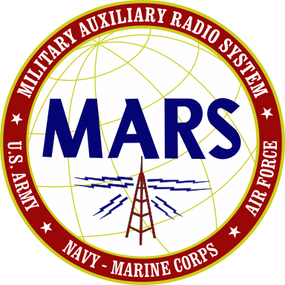

Slide 27
Military Auxiliary Radio System (MARS)
Department of Defense sponsored auxiliary communication program, three separately managed and operated programs
US Army
US Navy/Marine Corp
US Air Force
Operate disciplined and structured nets on assigned military radio frequencies adjacent to the Amateur bands
MARS has a strict set of rules regarding the type, content and format of messages
Special call signs are issued for MARS use

Slide 28
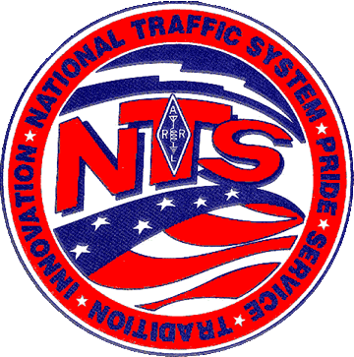
National Traffic System

Slide 29
National Traffic System (NTS)
NTS consists of local, regional and national nets operating on a regular basis to pass messages (traffic) from place to place
Day-to-day usage
Handles non-critical organizational messages for its own members and ARRL field organizations, radiograms for the public, and various personal messages
E-mail
NTS has seen a significant decrease in the number of messages passed through the system, and a corresponding decrease in membership and overall effectiveness
NTS still has an important role in emergency communication

Slide 30
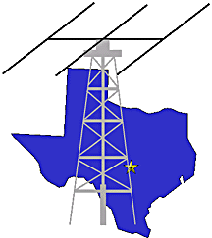
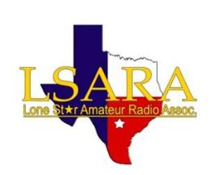
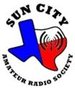
Local Radio Clubs
Williamson County ARC

Slide 31
Local Radio Clubs
Not every area has a working ARES or other nationally affiliated emcomm group
In many cases, the void is filled by local radio clubs who either work informally with served agencies, or with a formal MOU

Slide 32

National Communications System (NCS)
NCS consists of 23 government organizations tasked with ensuring that the Federal Government has the necessary communication capabilities under all
Forest Service,
Federal Emergency Management Agency (FEMA),
Coast Guard,
FBI,
ATF, and others who have a variety of communication assets.
The Manager of the NCS is also the Director of the Defense Information Systems Agency (DISA), usually an Air Force general.

Slide 33
SHARES
US Government's "Shared Resources System"
pairs MARS with various federal agencies and state emergency operations centers to provide a high frequency (HF) communication backbone if normal communication systems should fail
Key communications companies such as AT&T, and agencies such as the Red Cross have SHARES radios

Slide 34
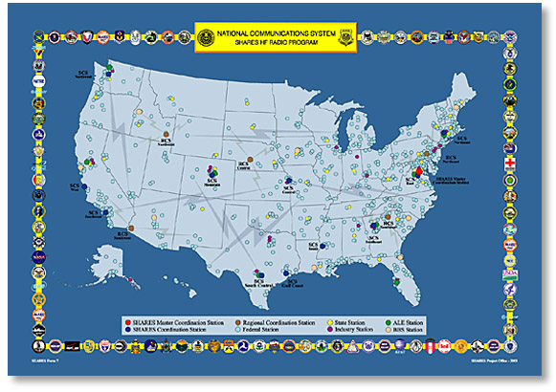
SHARES
http://www.ncs.gov/n3/shares/shares.htm

Slide 35
FEMA INTEGRATED NETWORK
Facilities linked with high-speed terrestrial circuits provide integrated voice, data, and video network service
Routers connect FEMA facilities to provide access to the internet
Private Branch Exchange (PBX) systems provide voice capability through FEMA’s Integrated Network, Public Network, and Federal Telephone System (FTS)
Disaster Field Offices are quickly added to architecture to provide a robust field operating environment

Slide 36
FEMA National Radio System (FNARS)
Provide a minimum essential emergency communication capability among federal agencies, state, local commonwealth, and territorial governments in times of national, natural and civil emergencies
FEMA monitors the FNARS HF frequencies on a daily basis
FNARS is an Single Side Band (SSB) radio system that can transmit both voice and data, and that has the capability to operate in both secure and non-secure modes
At the state level, FNARS radios are typically located at the state emergency operations center (EOC)

Slide 37
FNARS

Slide 38
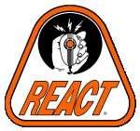
http://www.reactintl.org/

Slide 39
Radio Emergency Associated Communications Teams (REACT)
REACT is a national emcomm group
members include Citizen's Band (CB) radio operators, hams, and others
In addition to CB and Amateur Radio, they may use General Mobile Radio Service (GMRS), Family Radio, and the Multiple Use Radio Service (MURS).
Organizational structure similar to ARES
Mission is somewhat broader than that of ARES.
Offer crowd and traffic control, logistics, public education, and other services that usually (but not always) include a need for radio communication.

Slide 40

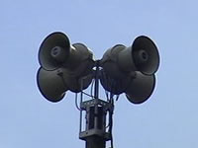
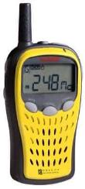


Emergency Warning Systems

Slide 41
Emergency Alert System -- EAS
Current EAS system has evolved from the earlier Emergency Broadcast System (EBS) and the original "CONELRAD System" developed during WWII
EAS relies on radio and TV broadcast stations to relay emergency alert messages from federal, state, and local authorities
Notes:
You may have heard the required weekly EAS tests performed by radio and TV stations and their distinctive digital "squawk" sound.

Slide 42
NOAA Weather Alert and National Weather Radio (NWR)
NWR is an all-hazards public warning system, broadcasting forecasts, warnings and emergency information 24 hours a day directly to the public
Natural (e.g., tornado, hurricane, floods, earthquakes)
Technological accidents (e.g., chemical release, oil spill, nuclear power plant emergencies, maritime accidents, train derailments)
AMBER alerts
Terrorist attacks
NWR uses seven frequencies in the 162MHz band
Specific Area Message Encoding (SAME)
remain silent until an alert is received for a specific geographic area
Notes:
Newer "weather alert" radios are available from a variety of manufacturers with the digital Specific Area Message Encoding (SAME) alert mechanism. SAME equipped radios will remain silent until an alert is received for a specific geographic area. The user programs one or more five-digit FIPS codes for the areas they wish to monitor. When the NWS broadcasts the alert with the SAME code matching that programmed into the receiver, the receiver will activate and allow you to hear the audio message concerning the alert. Some receivers also provide a textual display of the alert information. The NWS tests the SAME network at least once weekly, and the radio will indicate that it has heard the test alert within the past week.

Slide 43
NAWAS (National Warning System)
“Hardened" and secure national wireline phone network connecting the warning points in each state (usually the state police HQ or state EOC) to the Federal Government
The National Warning System (NAWAS), a major component of the Civil Defense Warning System (CDWS), was established with the primary purpose of providing a capability to warn the nation of a threat of a nuclear attack
Center of NAWAS operations is the National Warning Center at NORAD's Cheyenne Mountain command and control complex in Colorado

Slide 44
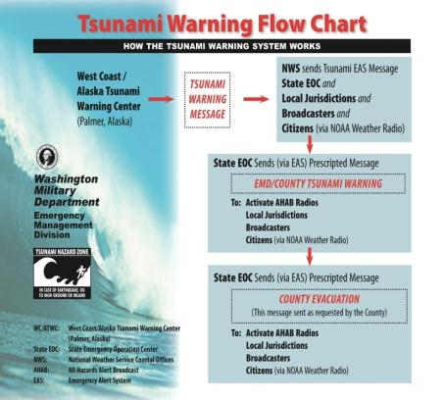
Tsunami Warning System
National and international network of warning points to provide timely exchange of tsunami warning information
Information is relayed to a wide range of government, civil defense, military, and international tsunami research/warning points within each country or area

Slide 45
National Earthquake Information Center (NEIC)
U.S. Geological Survey operates the National Earthquake Information Center, located in Golden, Colorado
Issues rapid reports for those earthquakes that register at least 4.5 on the Richter Scale in the United States, or 6.5 on the Richter Scale (or are known to have caused damage) anywhere else in the world
Public warning reports are disseminated in the affected areas via the NWR and EAS systems

Slide 46
Summary
Any questions before the quiz?

Slide 47
Time for a Quiz
Take 30 Seconds adjust your workspace

Slide 48
30
Seconds

Slide 49
20
Seconds

Slide 50
10
Seconds

Slide 51
9
Seconds

Slide 52
8
Seconds

Slide 53
7
Seconds

Slide 54
6
Seconds

Slide 55
5
Seconds

Slide 56
4
Seconds

Slide 57
3
Seconds

Slide 58
2
Seconds

Slide 59
1
Seconds

Slide 60
Let's get started!

Slide 61
Topic 4 Question
Which of the following best describes the ARES organizational structure?
ARRL -District-Section-County
ARRL-Section-District-County
ARRL -County-Region-Section
ARRL -State - Region-Section

Slide 62
Topic 4 Question
Which of the following best describes the ARES chain of command within a Section?
Section Manager-District Emergency Coordinator-Emergency Coordinator, Assistant Emergency Coordinator -Section Emergency Coordinator
Section Emergency Coordinator- Section Manager-District Emergency Coordinator-Emergency Coordinator-Assistant Emergency Coordinator
Section Manager-Section Emergency Coordinator-District Emergency Coordinator-Emergency Coordinator-Assistant Emergency Coordinator
Section Manager-Section Emergency Coordinator-Emergency Coordinator District Emergency Coordinator-Assistant Emergency Coordinator

Slide 63
Topic 4 Question
Which of the following best describes a Level 2 RRT?
Is a first responder in any emergency
Operates a few strategically placed stations within the first hour of an emergency
Responds within a few hours and is prepared with longer term (72 hour) jump kits
Is always affiliated with SATERN

Slide 64
Topic 4 Question
Which of the following best describes an ARES Mutual Assistance Team (ARESMAT)?
Is generally available for tasks lasting less than one day
Is always from the local area
An ARES team who are willing and able to travel to another area
Is called out only when the President suspends regular Amateur operations

Slide 65
Topic 4 Question
Which of the following is true about REACT?
REACT is a part of ARRL
REACT does not have an MOU with ARRL
REACT's mission is more restricted than that of ARRL
REACT's resources include CB, Amateur Radio, GMRS, FRS, and MURS

Slide 66
Any Questions Before Starting Topic 5a?

